Slide 1


Biological Research
Data Management Team
How to work with your Data
Prof. Andrew Millar
Dr. Livia Scorza
Dr. Tomasz Zieliński
bio_rdm@ed.ac.uk

Slide 2
Course Content
Open Science and FAIR Principles
Organising and Documenting Your Data
Introduction to metadata
(Meta)data in Excel
Working with files
Introduction to Data Management Planning
Notes:
Alternative to learning objectives

Slide 3
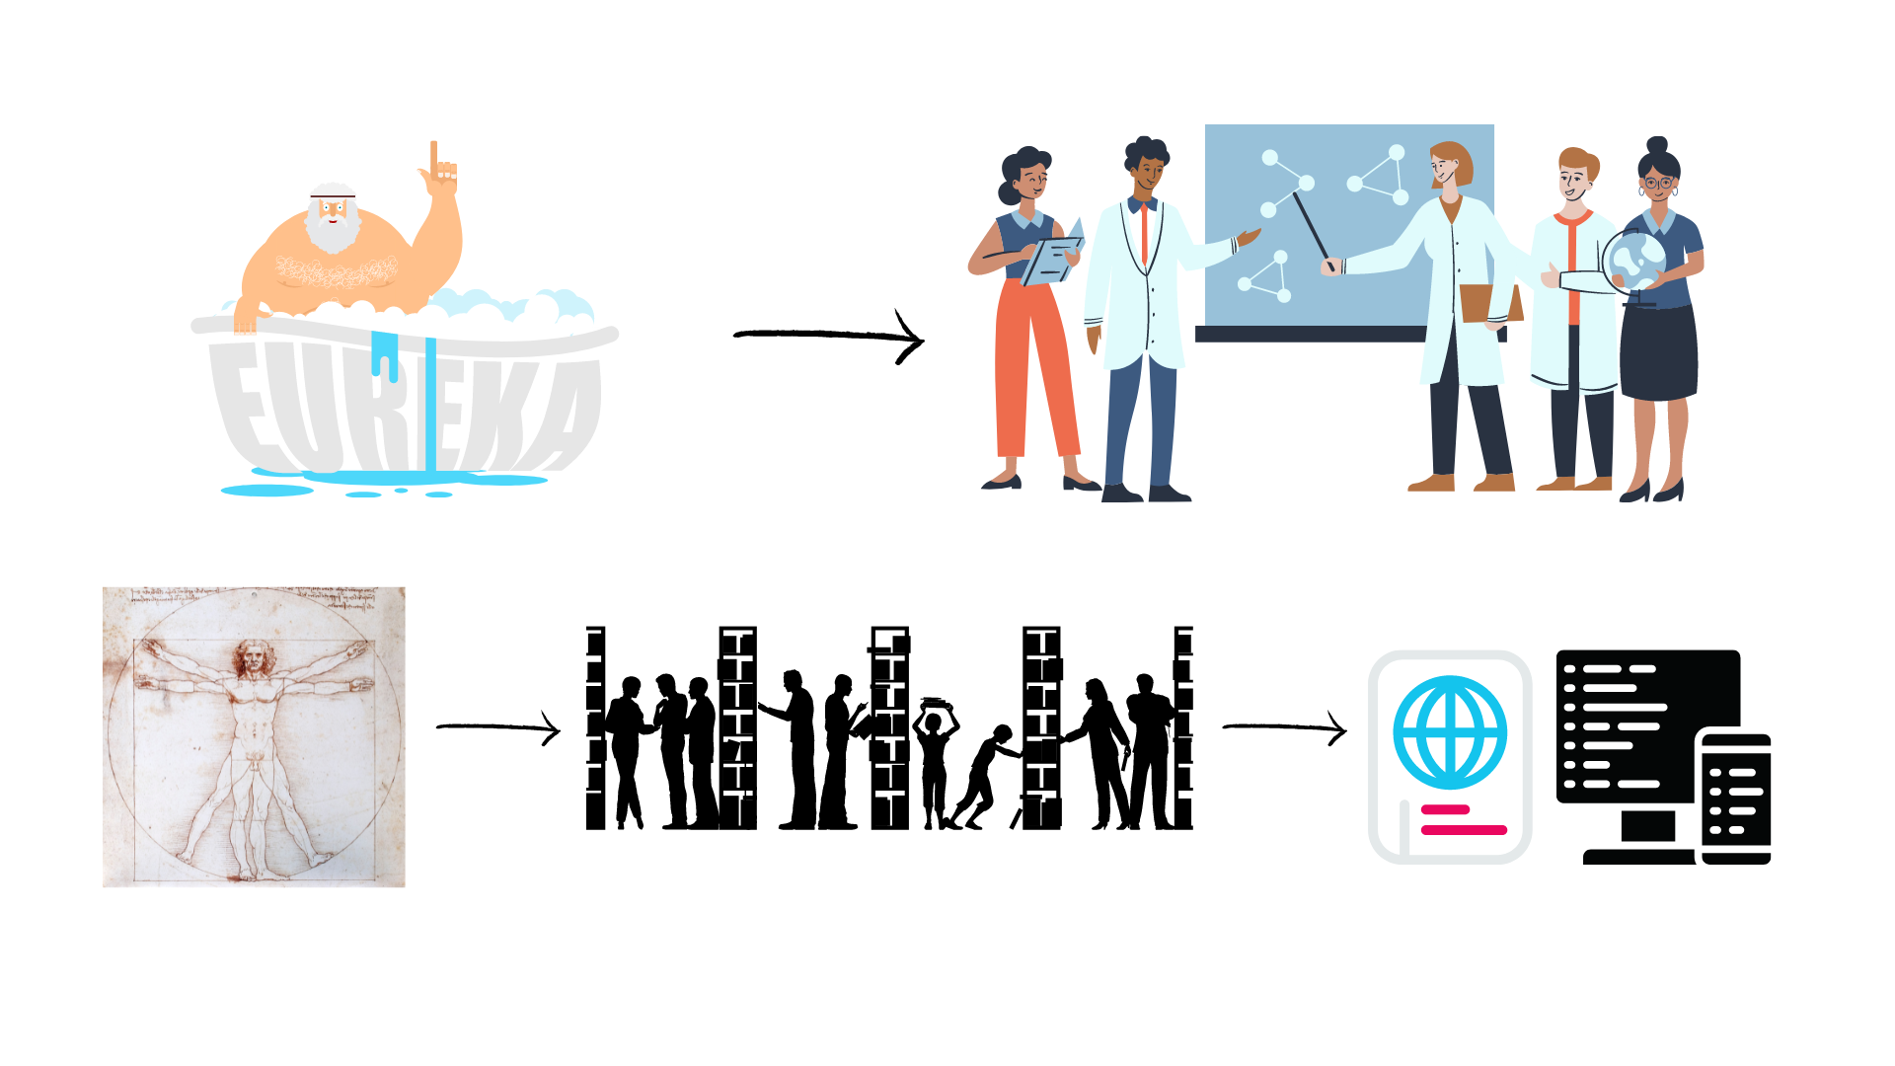
Evolution of Open Science
Level of openness in research

Slide 4

Open Science
Open science is transparent and accessible knowledge
that is shared and developed
through collaborative networks.

Slide 5






Open Science
Open science is the movement to make scientific research accessible to all levels of society
general public
amateurs
professionals
students
teachers
publications
data
physical samples
software
Digital technologies for diffusing knowledge

Slide 6
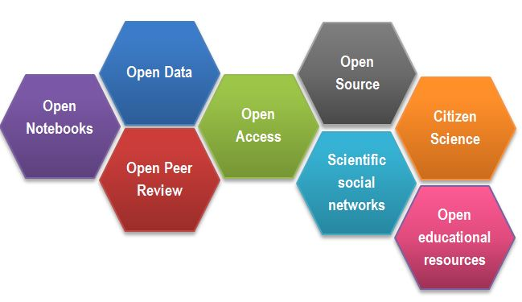
Open Science
CREDITS [1] CC BY

Slide 7
Outcomes of Openness
Collaboration
Speed
Unpulished / negative results
Re-use
Learn by example
Feedback

Slide 8
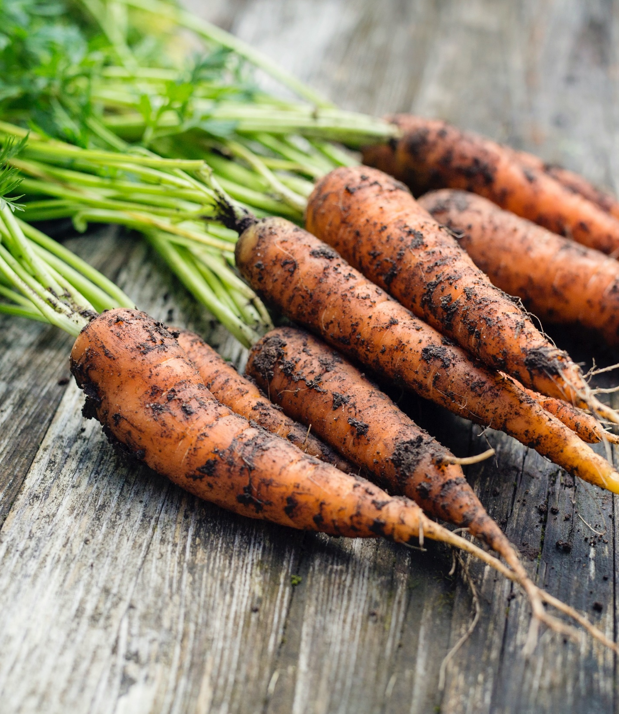
Motivation
“stick”
Large UK funding bodies such as The Wellcome Trust are big supporters of Open Science
“carrot”
….

Slide 9
Your motivators
….

Slide 10
But how (not) to share in practice

Slide 11
Data from publications
…

Slide 12
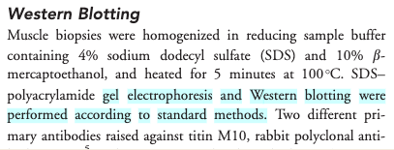
Impossible protocol

Slide 13
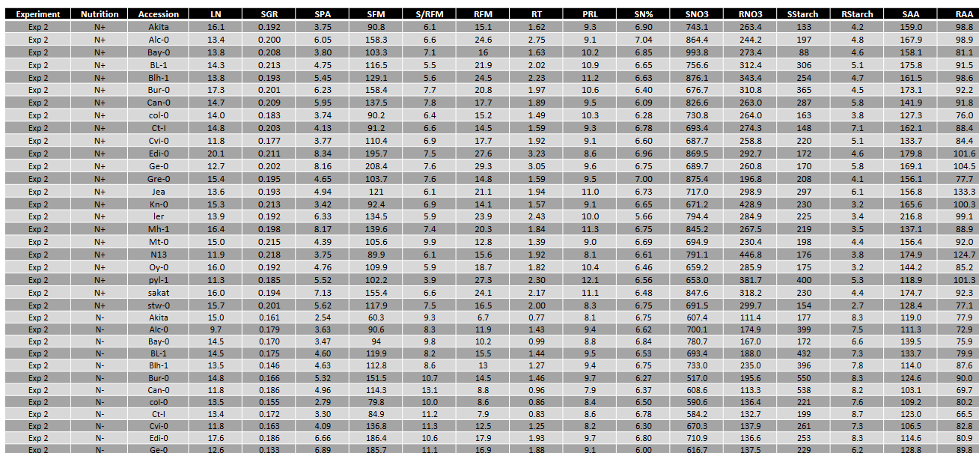
Impossible average

Slide 14
Impossible average

Slide 15
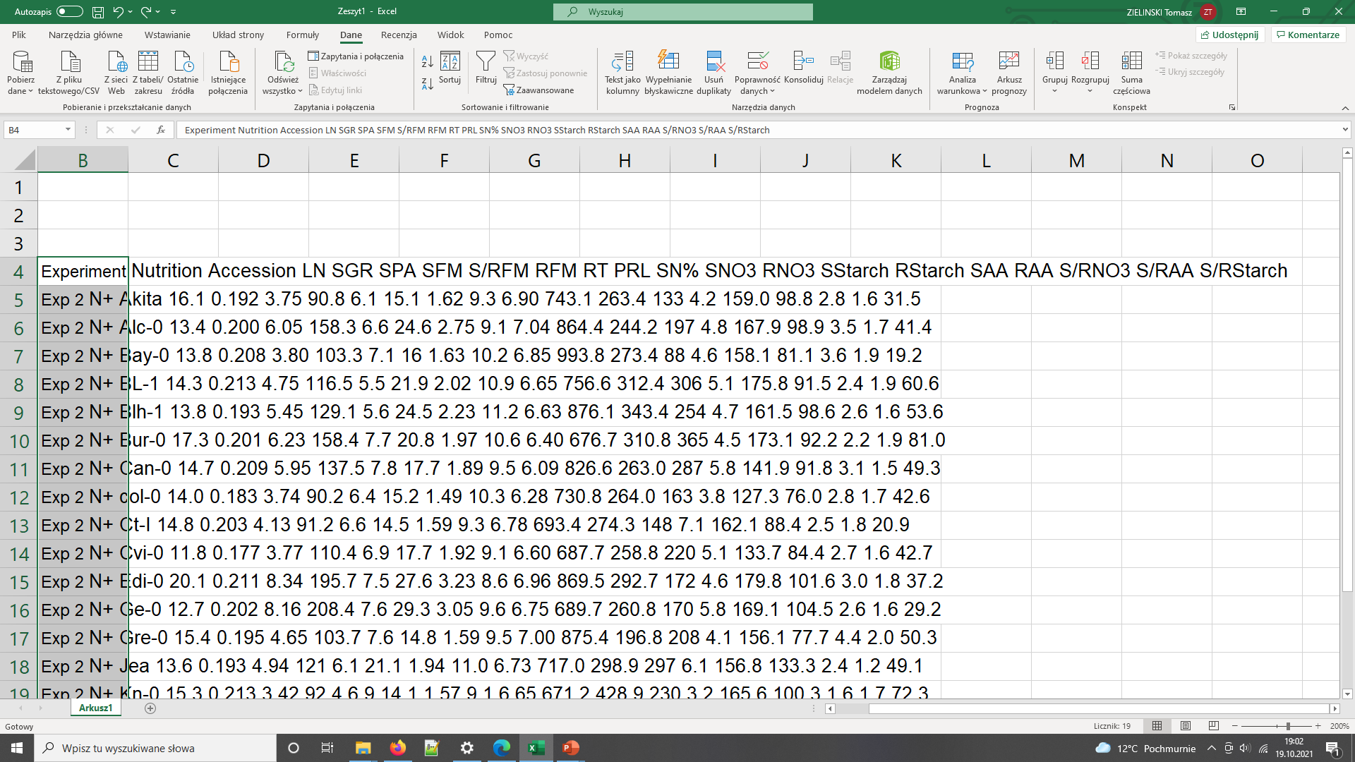
Impossible average

Slide 16
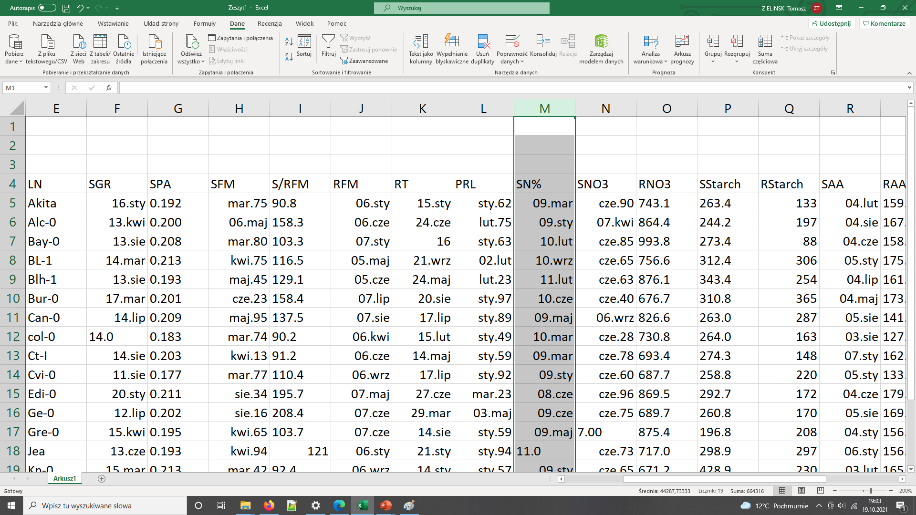
Impossible average

Slide 17
Common problems
The first example
the protocol was difficult to find (the loops),
the protocol difficult to access (pay wall),
and not reusable as it lacked the necessary details (dead-end).
The second example not interoperable and reusable
Numerical data as graphs / pdf
Obscure column headers

Slide 18
Typical problems
Only averaged data available
No numerical data available
Data tables as PDF files in supporting information
Vendor specific file formats
Links to non existing group websites / databases
Data / Code “on request”

Slide 19

FAIR principles
CREDITS [5] CC BY

Slide 20
FAIR principles
Findable:
persistent identifiers pointing to the data
descriptions that allow discovery by both humans and computers
Accessible:
(meta)data retrieval by standard protocols (http)
metadata available even when the data are not
Interoperable:
(meta)data saved in open/common format (interpretable for various tools)
(meta)data should use vocabularies that follow FAIR principles.
Re-usable:
data should be well-described so that they can be replicated and/or combined in different settings
conditions of the reuse should be stated with a clear license

Slide 21
FAIR in biological practice
Findable & Accessible
Deposit data to an external, reputable public repository.
Repositories provide persistent identifiers (PIDs), catalogue options, advanced metadata searching, and download statistics. Some repositories can also host private data or provide embargo periods, meaning access to all data can be delayed.
General “data agnostic” repositories: Dryad, Zenodo, FigShare, Dataverse.
Domain specific: UniProt – protein data, GenBank – sequence data, MetaboLights – metabolomics data.
Check FAIRsharing.org for your type!!!

Slide 22
FAIR in biological practice
Interoperable
Use .csv or .xls files for numerical data. Never share data tables as word or pdf
Provide underlying numerical data for all plots and graphs
Use common file formats (domain specific)
Convert proprietary binary formats to open ones. For example convert Snapgene to Genbank/SBOL, microscopy multistack images to OME-TIFF

Slide 23
FAIR in biological practice
Reusable
describe your data well (good metadata)
write a README file describing the data
provide as many details as possible (prepare good metadata)
use descriptive column headers for the data tables
tidy data tables, make them analysis friendly
use (meta)data formats (e.g. SBML, SBOL)
use commonly known terms and PIDs in descriptions
follow Minimum Information Standards
attach license files

Slide 24
FAIR and You
Citable
Track & Countable
Intelligible
Reproducible
CREDITS [5] CC BY

Slide 25
FAIR example
What makes it FAIR
https://doi.org/10.5281/zenodo.6339631

Slide 26
Break

Slide 27

Metadata

Slide 28

What is data?
Data can be defined as facts, figures, or information that is collected, used and stored for reference or analysis
Information about physical samples:
animal/ plant tissue (live, in culture, frozen, etc)
bacterial / yeast stocks etc
Quantitative / numerical data: Spreadsheets (tables), csv files
Images (pictures, microscopy images, 3D scans)
Code (Software programs, analysis codes, algorithms)
DNA/RNA sequences (plasmids, sequencing files, etc)
Protocols (recipes, laboratory and measurement protocols)
Designed by Anindyanfitri / Freepik

Slide 29
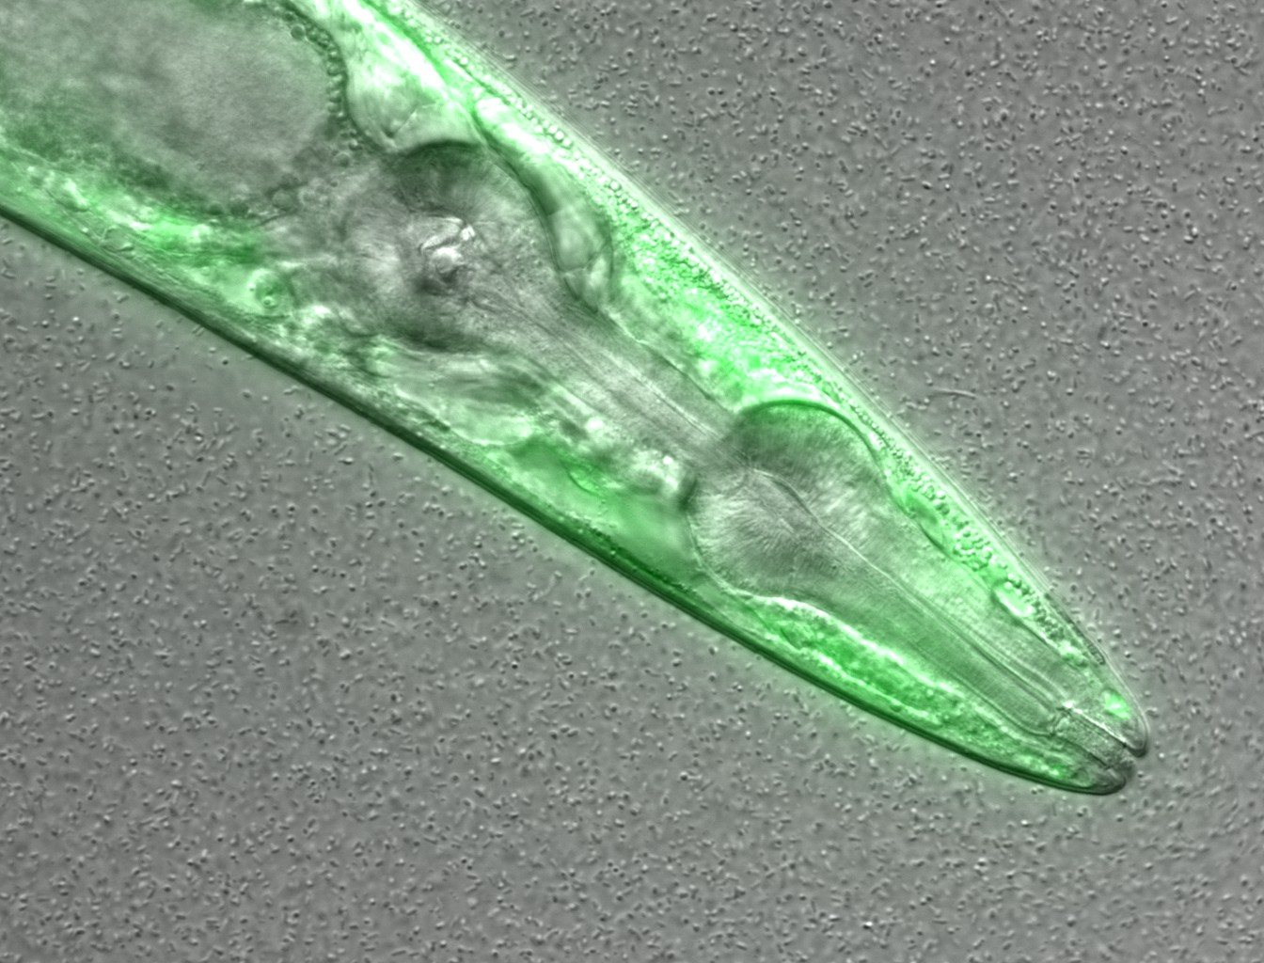
What information can you guess without the associated description (metadata)?
Figure credits: María Eugenia Goya
Notes:
Image metadata
Name: OP50 D10Ad_06.czi Image ID: 3485 Owner: Maria Eugenia Goya ORCID: 0000-0002-5031-2470
Acquisition Date: 2018-12-12 17:53:55 Import Date: 2020-04-30 22:38:59 Dimensions (XY): 1344 x 1024 Pixels Type: uint16 Pixels Size (XYZ) (µm): 0.16 x 0.16 x 1.00 Z-sections/Timepoints: 56 x 1 Channels: TL DIC, TagYFP ROI Count: 0
Tags: time course; day 10; adults; food switching; E. coli OP50; NL5901; C. elegans
Dataset metadata
Name: Figure2_Figure2B Dataset ID: 263 Owner: Maria Eugenia Goya ORCID: 0000-0002-5031-2470
Description: The datasets contains a time course of α-syn aggregation in NL5901 C. elegans worms after a food switch at the L4 stage:
E. coli OP50 to OP50 Day 01 adults Day 03 adults Day 05 adults Day 07 adults Day 10 adults Day 13 adults
E. coli OP50 to B. subtilis PXN21 Day 01 adults Day 03 adults Day 05 adults Day 07 adults Day 10 adults Day 13 adults
Images were taken at 6 developmental timepoints (D1Ad, D3Ad, D5Ad, D7Ad, D10Ad, D13Ad)
* Some images contain more than one nematode.
Each image contains ~30 (or more) Z-sections, 1 µmeters apart. The TagYFP channel is used to follow the alpha-synuclein particles. The TL DIC channel is used to image the whole nematode head.
These images were used to construct Figure 2B of the Cell Reports paper (https://doi.org/10.1016/j.celrep.2019.12.078).
Creation date: 2020-04-30 22:16:39
Tags: protein aggregation; time course; E. coli OP50 to B. subtilis PXN21; food switching; E. coli OP50; 10.1016/j.celrep.2019.12.078; NL5901; C. elegans

Slide 30

What is metadata?
Metadata is the data about data!
Description / information of the data
The data has little or no meaning without metadata
It should be continuously added to your research data
(not just at the beginning or end of a project!)

Slide 31
What information would you need to re-use that data?
Exercise
Suggestions:
Author
What it is
What was measured
Figure credits: María Eugenia Goya
Notes:
Image metadata
Name: OP50 D10Ad_06.czi Image ID: 3485 Owner: Maria Eugenia Goya ORCID: 0000-0002-5031-2470
Acquisition Date: 2018-12-12 17:53:55 Import Date: 2020-04-30 22:38:59 Dimensions (XY): 1344 x 1024 Pixels Type: uint16 Pixels Size (XYZ) (µm): 0.16 x 0.16 x 1.00 Z-sections/Timepoints: 56 x 1 Channels: TL DIC, TagYFP ROI Count: 0
Tags: time course; day 10; adults; food switching; E. coli OP50; NL5901; C. elegans
Dataset metadata
Name: Figure2_Figure2B Dataset ID: 263 Owner: Maria Eugenia Goya ORCID: 0000-0002-5031-2470
Description: The datasets contains a time course of α-syn aggregation in NL5901 C. elegans worms after a food switch at the L4 stage:
E. coli OP50 to OP50 Day 01 adults Day 03 adults Day 05 adults Day 07 adults Day 10 adults Day 13 adults
E. coli OP50 to B. subtilis PXN21 Day 01 adults Day 03 adults Day 05 adults Day 07 adults Day 10 adults Day 13 adults
Images were taken at 6 developmental timepoints (D1Ad, D3Ad, D5Ad, D7Ad, D10Ad, D13Ad)
* Some images contain more than one nematode.
Each image contains ~30 (or more) Z-sections, 1 µmeters apart. The TagYFP channel is used to follow the alpha-synuclein particles. The TL DIC channel is used to image the whole nematode head.
These images were used to construct Figure 2B of the Cell Reports paper (https://doi.org/10.1016/j.celrep.2019.12.078).
Creation date: 2020-04-30 22:16:39
Tags: protein aggregation; time course; E. coli OP50 to B. subtilis PXN21; food switching; E. coli OP50; 10.1016/j.celrep.2019.12.078; NL5901; C. elegans

Slide 32
What is metadata?
Adding metadata
Think as a consumer of your data not the producer!
What information would another researcher need to understand or reproduce your data?
Name of data creator/ Title
Project purpose and experimental hypothesis
Biological material, context, details on data acquisition, experimental conditions, etc.

Slide 33
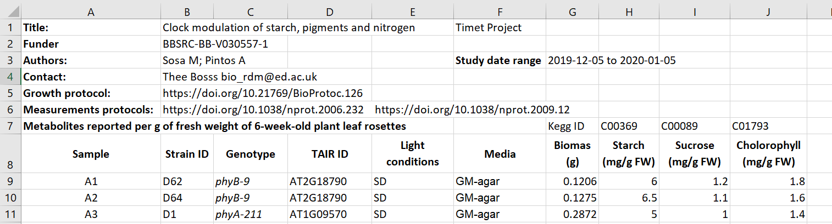
Metadata examples (tables or readme)
Metadata embedded in spreadsheet
Figure credits: Tomasz Zielinski and Andrés Romanowski

Slide 34
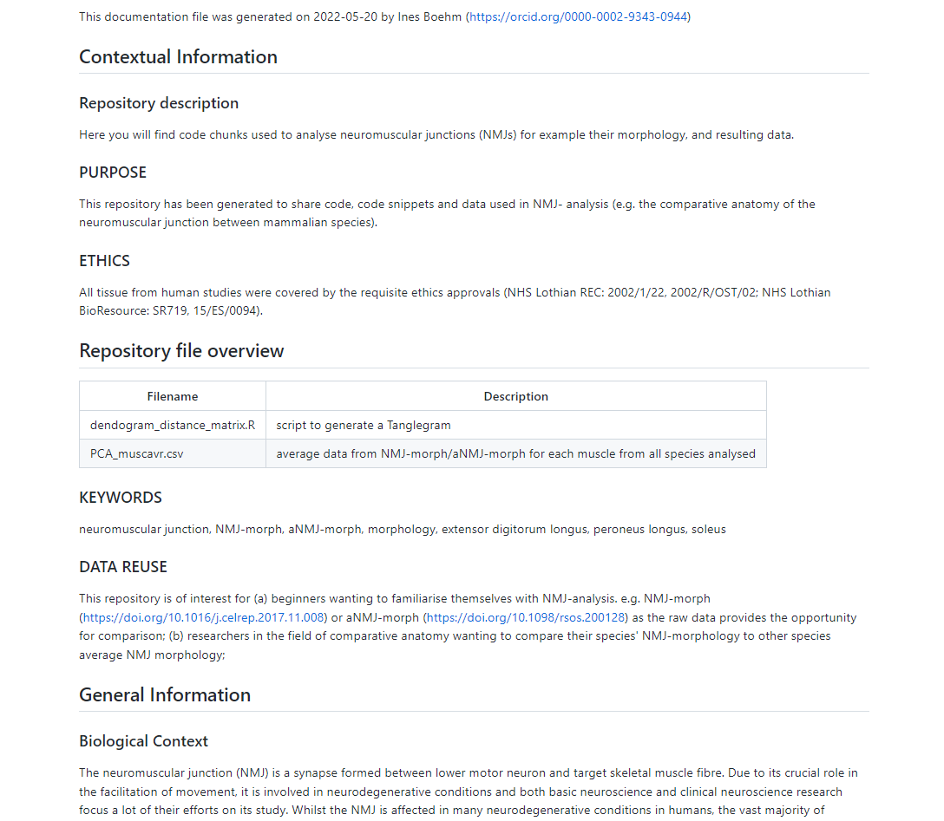
Metadata examples (tables or readme)
Metadata as README file
https://github.com/Boehmin/NMJ_analysis/blob/main/README.md

Slide 35

(Meta)data in Excel

Slide 36
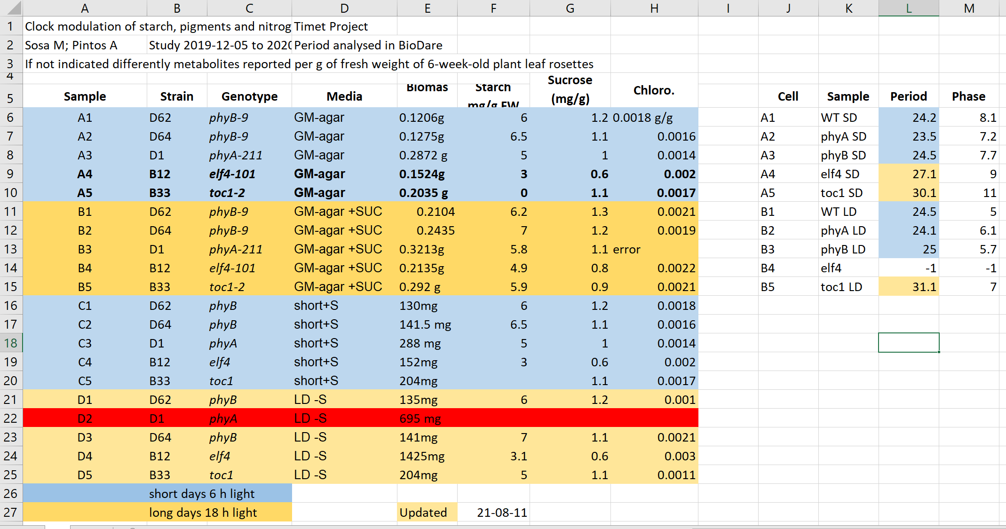
Exercise 1
What can go wrong with data in Excel

Slide 37
Exercise 1: Solution
Why are the data in two tables, are period measurement related to the metabolics i.e. same samples?
Do colours in period table have the same meaning?

Slide 38
Exercise 1: Solution
Why is row 22 is red any why does H13 says error?

Slide 39
Exercise 1: Solution
What is the meaning of values in media column?

Slide 40
Exercise 1: Solution
Are the genotypes same in different blocks or not?

Slide 41
Exercise 1: Solution
Before averaging the biomass, weight needs conversion to the same unit, and the unit should be removed from the text.

Slide 42
Exercise 1: Solution
Averaging per genotype needs manual selection of the suitable entries

Slide 43
Common Spreadsheet errors
Using multiple tables
Confuses both humans and computers.
Using multiple tabs
Harder to do programmatic analysis and can be missed, but can be a good place to put secondary data. Use with caution.

Slide 44
Common Spreadsheet errors
Not filling in zeros
Zero can mean no data recorded, but a computer will treat the value as zero. Therefore, record zeros as zeros and missing data as nulls.
Using problematic null values
Best to record nulls as blanks in data fields, and keep a neighbouring column to comment that it’s null. NEVER: 0, -1, -100, 1000

Slide 45
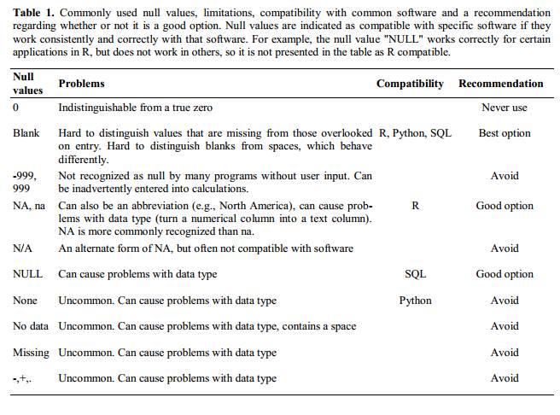
Common Spreadsheet errors
Not filling in zeros
Zero can mean no data recorded, but a computer will treat the value as zero. Therefore, record zeros as zeros and missing data as nulls.
Using problematic null values
Best to record nulls as blanks in data fields, and keep a neighbouring column to comment that it’s null. NEVER: -1, -100, 1000

Slide 46
Common Spreadsheet errors
Using formatting to convey information organising data
Computers can’t interpret formatting easily. Better to keep a column/ field to record that data. Don’t merge cells.

Slide 47
Common Spreadsheet errors
Placing comments or units in cells
Computers struggle with these
Entering 1 < piece of information in a cell
Keep 1 data in each cell, and use as many cells as necessary
Male 30
Female 28
LD 30C SUC
LD 15C NO
SD 30C NO
Sex | Age
Male | 30
Female | 28
Day_length | Temp_C | Added_ Sucrose
LD | 30 | YES
SD | 15 | NO
SD | 30 | NO

Slide 48
Common Spreadsheet errors
Inconsistency in used values
Be consistent!
E. Coli, EColi, Escherichia coli
Using problematic field names
Underscores not spaces. Avoid abbreviations. Include units.
Good Name | Good Alternative | Avoid
Max_temp_C | MaxTemp | Maximum Temp (°C)
Precipitation_mm | Precipitation | precmm
Mean_year_growth | MeanYearGrowth | Mean growth/year
sex | sex | M/F
weight | weight | w.
cell_type | CellType | Cell Type
Observation_01 | first_observation | 1st Obs

Slide 49
Common Spreadsheet errors
Using special characters in data
Computers struggle with these
Values without fields: always label values with column headers
Ann Smart and Daniele Hardwork
Starch content in Arabidopsis under different light conditions
Authors | Ann Smart | Daniele Hardwork
Title | Starch content in Arabidopsis under different light conditions

Slide 50
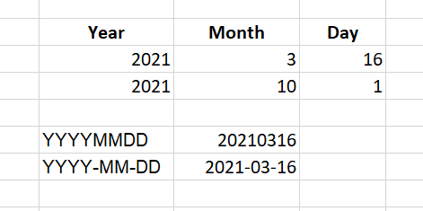
Dates
Store dates in 3 columns for year, month and day or
Store the date as an ISO string: YYYYMMDD YYYY-MM-DD

Slide 51
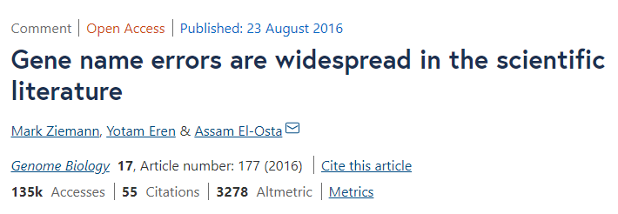
Outsmarted by Excel
Roughly 1 in 5 of 3,600 genetics papers investigated included errors in their gene lists that were due to Excel automatically converting gene names to things like calendar dates or random numbers.
When using text files (.csv, .tsv), You should always document what format you are using to represent dates.

Slide 52
To use or not to use Excel
Excel file format .xlsx is now open, and nowadays it is admissible as being FAIR.
However, plain text files like coma or tab separated values (.csv, .tsv) can be accessed without any special software and also be easily imported into other formats and environments, such as SQLite and R. They’re good for maximum portability and endurance.
If you only use Excel, and so does your community, just keep using it. Just be aware of possible pitfalls, especially when working with genes(protein)' names(accession numbers).

Slide 53
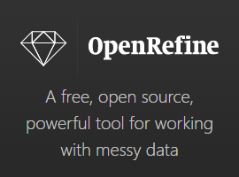
Cleaning data with OpenRefine
https://openrefine.org/
A powerful tool for working with messy data: cleaning it; transforming it from one format into another.
Find and merge the synonyms like: E. Coli, EColi, Escherichia coli into one,
Split values in the Name field into FirstName and LastName.
There is a carpentry course available: Data Cleaning with OpenRefine for Ecologists

Slide 54
(Meta)data in tables
Never use formatting to encode information
Include only one piece of information in a cell
It is easier to store data in the correct form than to clean data for reuse

Slide 55
Working with files

Slide 56
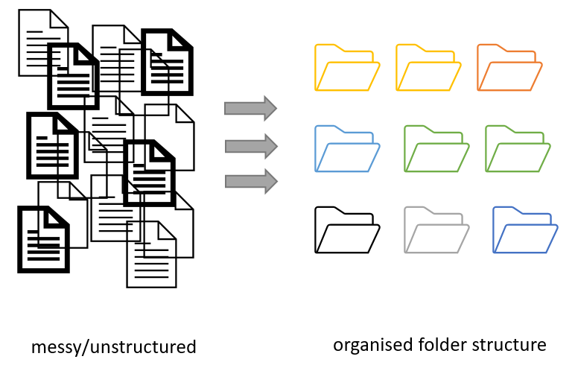
Project organization
Figure credits: Andrés Romanowski

Slide 57
Consistent naming and organization of files in folders has two main goals:
Find files quickly
Ability to tell the file content without opening it

Slide 58
It is important to develop standardized, naming convention
consistent
encoding of experimental factors
meaningful to you and your collaborators
give you a sense of the content
easily identify if something is missing

Slide 59
Naming files
Do’s:
Include date in the name. Use YYYY-MM-DD or YYYYMMDD format, eg. 20210920 Add date at the end of the file UNLESS you organize files chronologically
Include version number (if applicable) (orthogonal to date) Use leading zeroes (i.e.: v005 instead of v5)

Slide 60
Naming files
Do’s:
Encode biological or experimental relevant information, concisely, data category, etc. Example information to include:
sample, site, patient id
drug treatments, doses, names
environmental conditions
genotypes, markers,
technique
Data operation: normalized, cleaned, detrended, clustered

Slide 61
Naming files
Do’s:
Add leading zeros to numerical values
Add prefixes to numerical values: eg. S003, TR005

Slide 62
Naming files
Do’s:
Make sure the file format extension is present at the end of the name (e.g. .docx, .xlsx, .mov, .tif)
Add a PROJECT_STRUCTURE (README) file in your top directory which details your naming convention, directory structure and abbreviations

Slide 63
Naming files
Don'ts:
Avoid using spaces (use _ or - instead)
Avoid using commas and special characters (e.g. ~ ! @ # $ % < > ?[ ] { } ‘)
Avoid using language specific characters (e.g óężé)

Slide 64
Naming files
Don'ts:
Avoid using long names (should not exceed 30 characters)
Avoid repeating information from parent elements ELN_MI_20200101.tiff in Electron_Microscopy folder
Avoid using deep paths with long names (i.e. deeply nested folders with long names)

Slide 65
Exercise 6:
A good name

Slide 66
Folders vs Files
Folders permit grouping relevant data together
Folders help to keep files names short

Slide 67
Exercise 6:
Folders vs Files

Slide 68
Exercise 6
A)
Datasets for publication (grouped by raw data, results, scripts)
Pipelines (inputs, outputs, scripts and workflow)
B)
„By Figure” or „By analisys” – data and related code next to each other
C)
„By patient” (sample/subject) ... based on Brain Imaging Data Structure BIDS
D)
„By conditions/treatment” – mulitple biological materials under various experimental conditions

Slide 69
Break

Slide 70
Sharing as part of the workflow
CREATING DATA
RE-USING DATA
PROCESSING DATA
Time and effort
SHARING
DATA
ANALYSING DATA
PRESERVING DATA
work necessary to make outputs suitable for sharing

Slide 71
Sharing as part of the workflow
CREATING DATA
RE-USING DATA
PROCESSING DATA
Time and effort
SHARING
DATA
ANALYSING DATA
PRESERVING DATA
work necessary to make outputs suitable for sharing
standard research operations

Slide 72
Data Management Planning: What? Why? How?
What: thinking what data you will generate
Types of data, format, volume of the data
How: thinking about how you will
Organise, describe, securely store, and back your data up
Where: to ensure your data is available for replication re-use:
archiving, publishing, conditions of re-use
Notes:
How manage: organise, document, store, back-up.
How share and preserve: make data available for verification, replication, re-use.
Plan to prevent loss: HD failure, accidental delete, cat peeing on laptop.
Plan to prevent unauthorised access of sensitive/personal data.
DMPOnline:
Funder Templates
Plan broken down into sections:
data creating/collecting: size, format, type
documentation and metadata
quality assurance processes/standards
storage and back up plans
security measures for sensitive data
how, where, when share it (on publication)
how preserve
Includes lots of guidance for each section : funders / UoE /Data Curation Centre.

Slide 73
DMP example
https://www.wiki.ed.ac.uk/x/yesNGQ

Slide 74

DORA
Declaration on Research Assessment
the need to eliminate the use of journal-based metrics, such as Journal Impact Factors, in funding, appointment, and promotion considerations;
the need to assess research on its own merits rather than on the basis of the journal
the need to capitalise on the opportunities provided by online publication (such as relaxing unnecessary limits … exploring new indicators of significance and impact)
CREDITS [5] CC BY

Slide 75
Narrative CVs are comming
Generation of Knowledge
Development of Individuals and Collaborations
Supporting Broader Society and the Economy
Supporting the Research Community

Slide 76
Narrative CV
A broad definition of ‘output’ is used, such as datasets, patents and software.
Special attention is paid to Open Science, which outputs are openly available.
New metrics: retweets, online views and downloads, discussions, presence in mass media technology platforms

Slide 77
It is easier to be prepared than to fake it
It takes time to make the outputs public
The quality of open outputs is easy to assess
Timestamps

Slide 78
You want to
Have as many public outputs as possible:
Datasets in public repositories
Public protocols
Code packages
Public engagement
Involvement in Community groups, student groups etc
for your Narrative CVs

Slide 79
Learning
Practical recipes and guides:
https://faircookbook.elixir-europe.org/
https://rdmkit.elixir-europe.org/
Training
FAIR in (bio) practice https://carpentries-incubator.github.io/fair-bio-practice/

Slide 80
Quiz and feedback

Slide 81
FAIR in (bio) practice - workshop
Introduction to Open Science and FAIR
IP, Licensing and Openness
Metadata
Ontologies
(Meta)data in Excel
Record keeping
Working with files
Reusable analysis - Jupyter
Version control
Templates
Public repositories
Writing Data Management Plans

